Slide 2
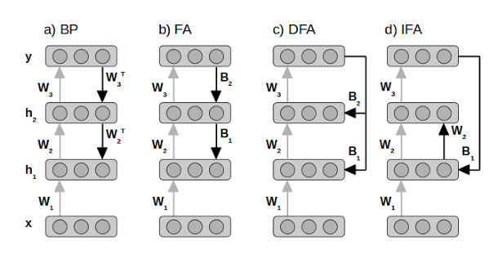
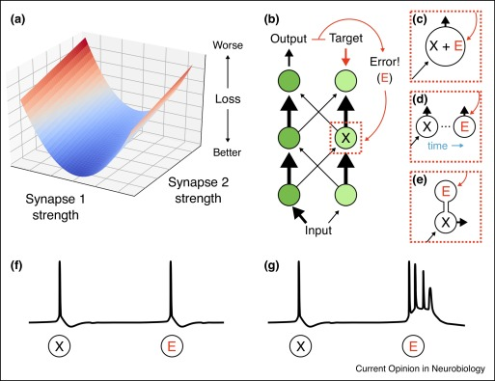
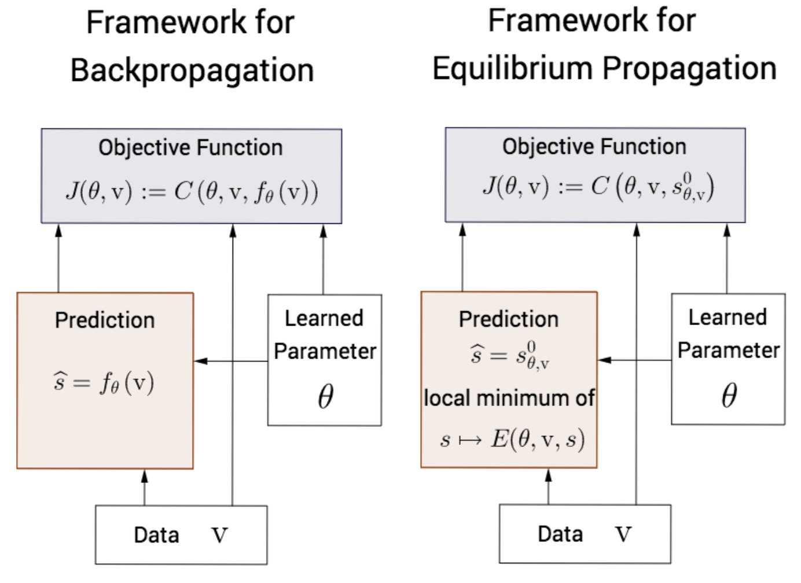
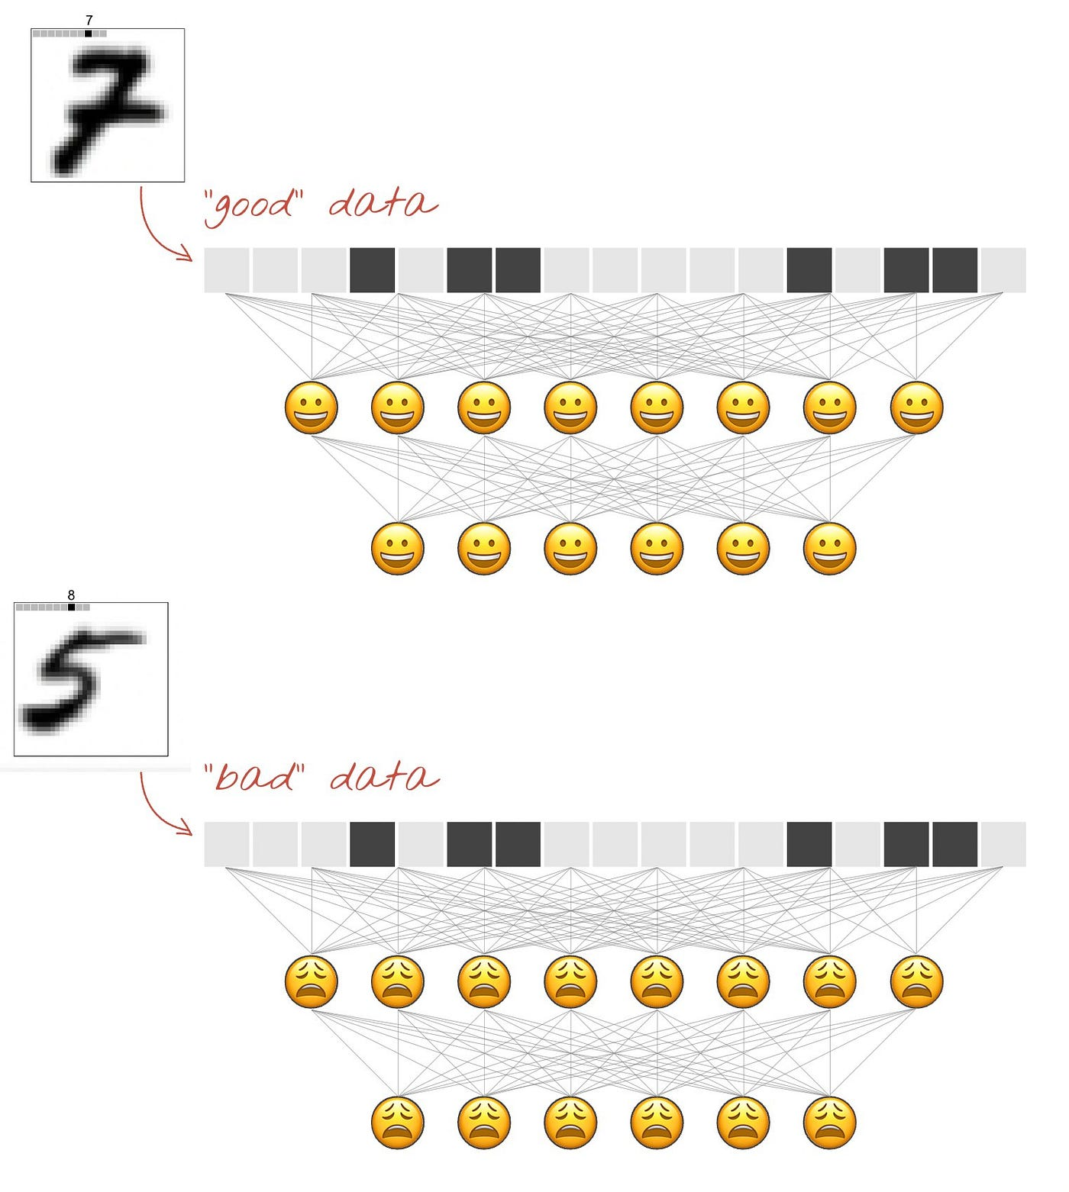
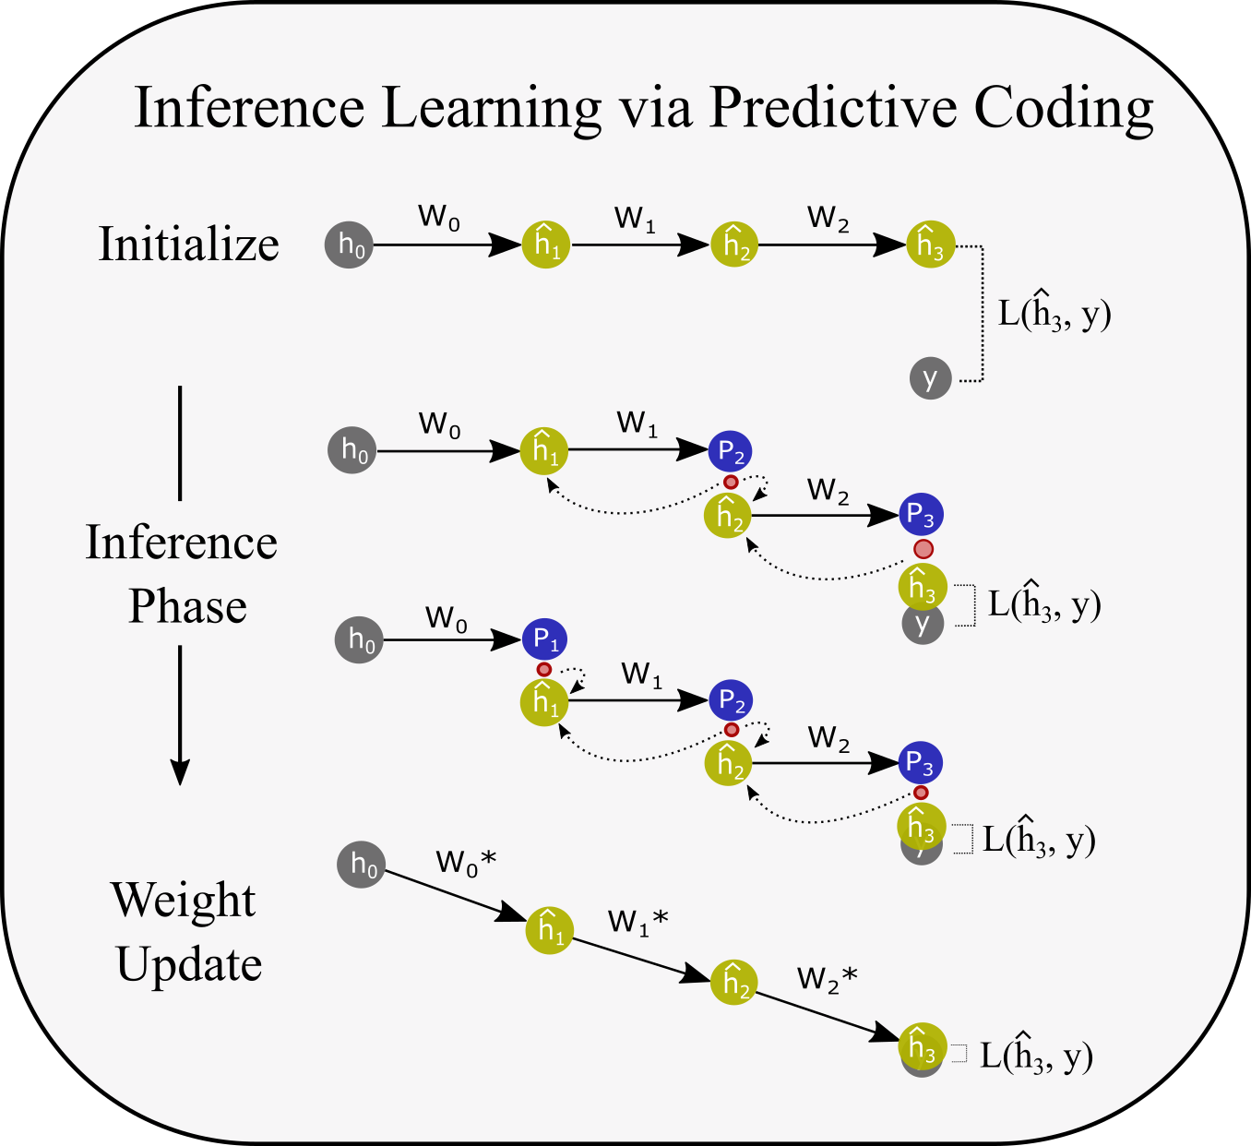
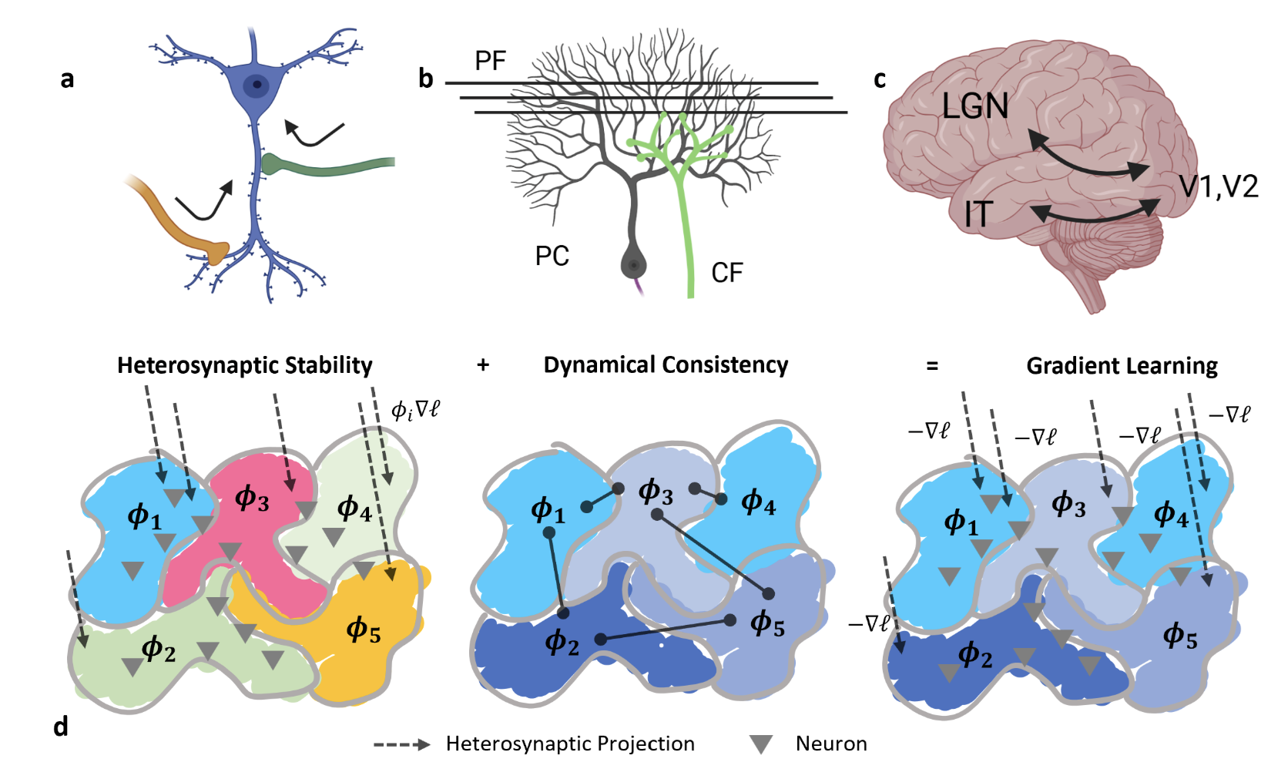
How can local units optimize a global loss function?

Slide 3
Local learning needs a new first principle
Most local learning asks how closely a local rule can approximate the gradient of a global loss function.
But with that framing, backpropagation should always win.
Can intelligent behavior arise from mechanisms that never have access to a global task objective?
One candidate primitive is homeostasis: many local components each trying to keep themselves viable.

Slide 4

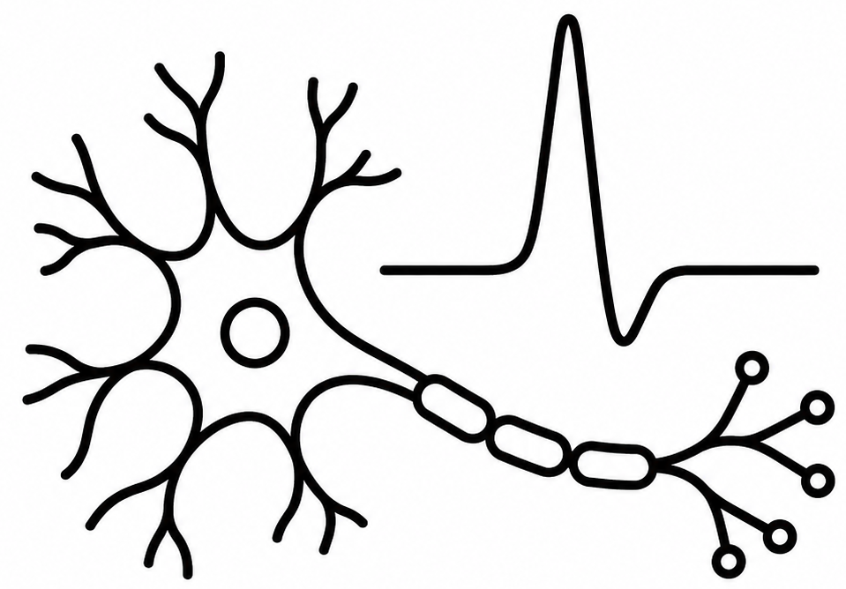

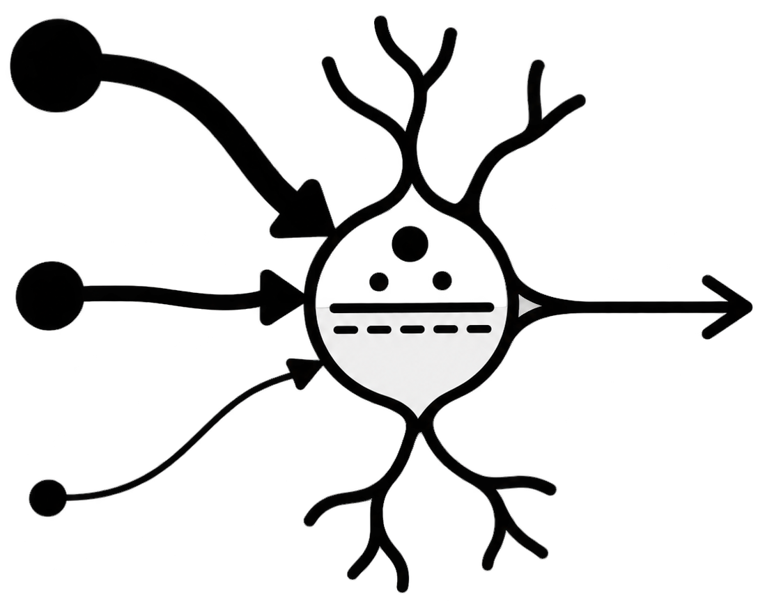
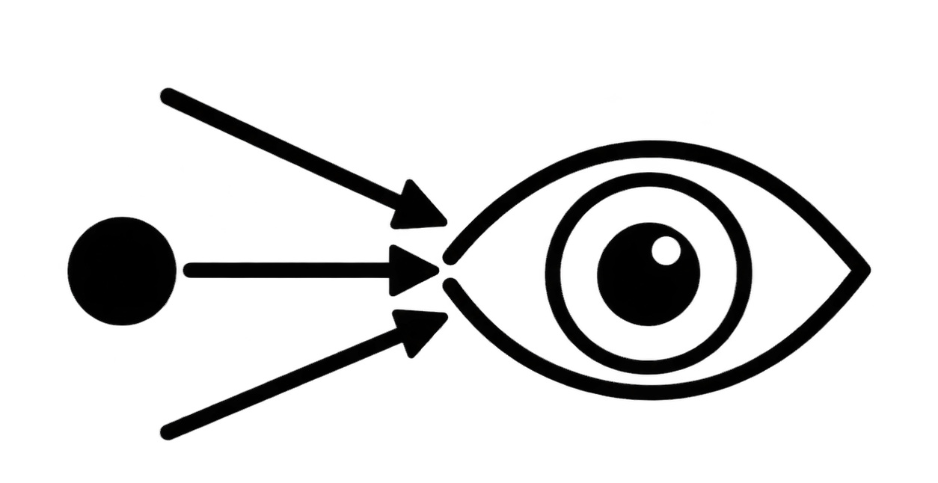
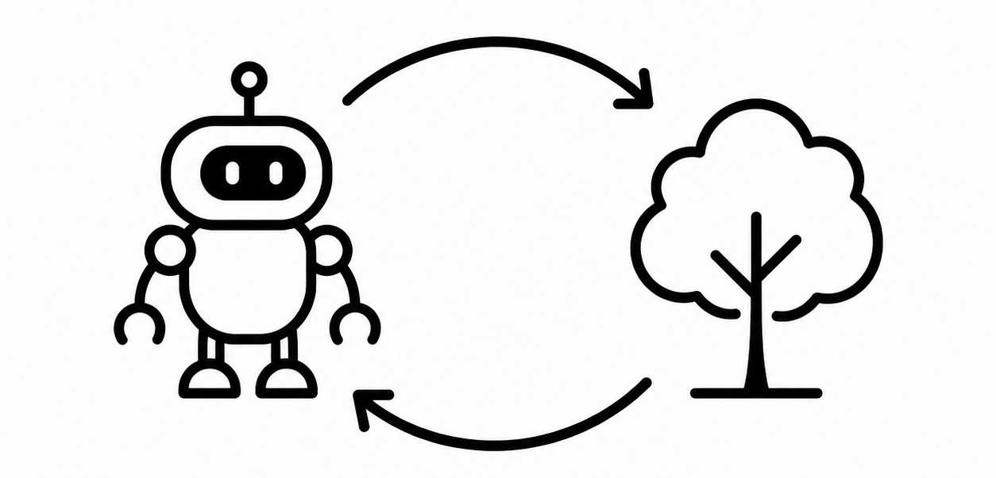
homeostatic error
updates
determines
thresholds, weights
neural activity
behavior
shapes future
drives
perturbs
changes
sensory input
agent-environment relationship
determines future
Behaviors that produce more tolerable sensory input become dynamically stabilized.
Notes:
Homeostatic regulation closes through two coupled loops: a short local loop, in which each neuron adjusts its thresholds and incoming weights, and a longer embodied loop, in which neural activity changes behavior, behavior changes future sensory input, and that input feeds back onto neural activity.
Both can return activity toward its viable regime: one by changing the neuron, the other by changing the perturbations acting on it.

Slide 5
Internal adaptation alone can not eliminate continually changing sensory perturbations.
Attractive behaviors make the sensory stream regular enough for local neural dynamics to stabilize.
homeostatic error
updates
determines
thresholds, weights
neural activity
behavior
shapes future
drives
perturbs
changes
sensory input
agent-environment relationship
determines future
Behaviors that produce more tolerable sensory input become dynamically stabilized.
Notes:
Homeostatic regulation closes through two coupled loops: a short local loop, in which each neuron adjusts its thresholds and incoming weights, and a longer embodied loop, in which neural activity changes behavior, behavior changes future sensory input, and that input feeds back onto neural activity.
Both can return activity toward its viable regime: one by changing the neuron, the other by changing the perturbations acting on it.

Slide 7
